Slide 1

Machine Learning and AI in Healthcare

Slide 2
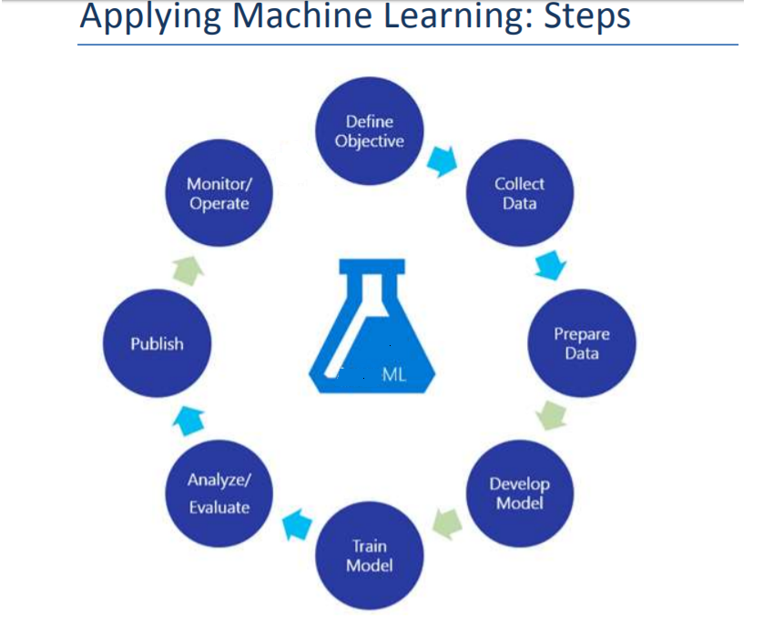
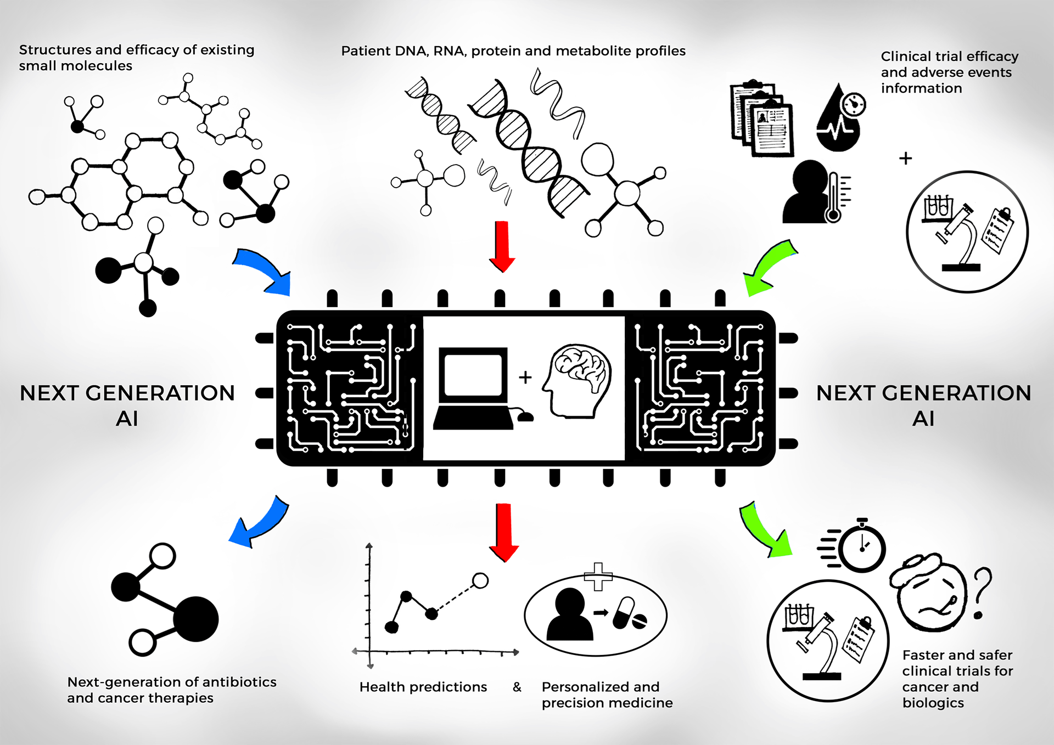

Slide 3
Machine learning and AI in Health Domain
McKinsey reports that machine learning could save pharma and medicine around $100 billion annually because of greater efficiencies in clinical trials, better insights for decision-making and innovative tools that can help consumers, physicians, regulators and insurers make informed decisions.
Its ability to spot patterns in massive volumes of data gives machine learning a wide range of applications like below :
Improving Medical Diagnosis
Patient Finder (or Rare Disease Patient Finder) using Claims Databases
Treatment Pathways & Patient Journey for Health Outcomes
Finding Physician Trends for Commercial Market Research
Risk-Based Monitoring in Clinical Trials
Physician Matching
Clinical Studies and R&D
Market Mix Modeling (or Promotion Response Modeling)
Drug Efficacy Detection
And etc.

Slide 4
Finding Physician Trends for Commercial Market Research
Using Associative Rules Mining, or “apriori”, data scientists can develop models with the outcome variable being a quantitative value related to Rx records.
For instance, given a dataset of physicians’ Rx records whose prescriptions of a particular medicine is marked as increasing or decreasing on a quarterly or monthly basis, we can use Associative Rules to find previously not known patterns
Eg. 75% of Physicians who accepted Cigna and was located in TX wrote 25% more Rx of Medicine A this month compared to the prior month
While, arguably, such patterns can be detected also using brute force methods, apriori is a much more efficient and statistically sound approach to finding patterns from large scale data

Slide 5
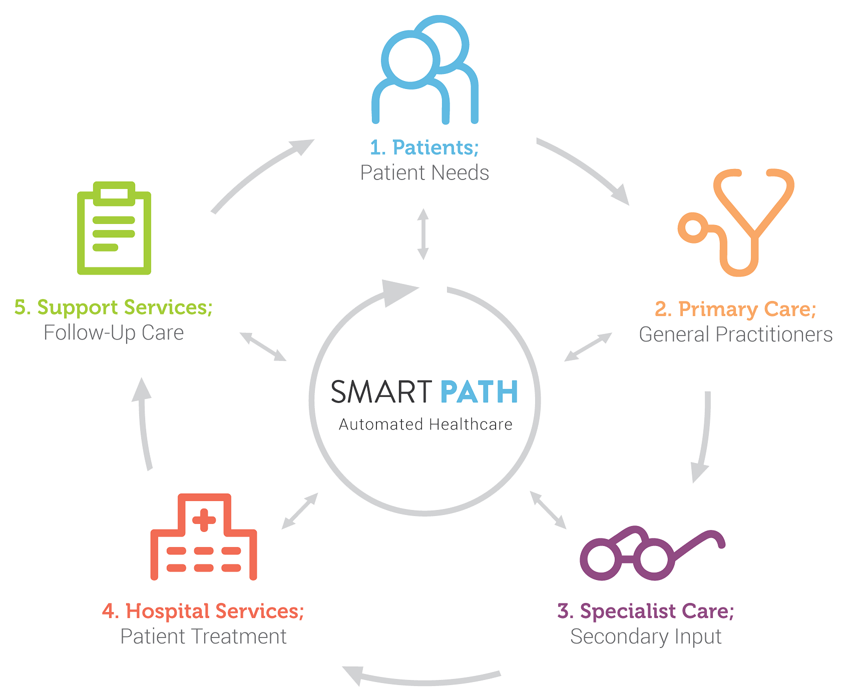
Treatment Pathways & Patient Journey for Health Outcomes
Patient Journey and Treatment Pathways refer to the process of finding how a patient progresses from one disease state to another through multiple lines of therapies.
In general, most of the current work focuses on using historical data to assess the pathways.
Using clustering and scoring models machine learning can help assess which treatments and/or drugs should be recommended for patients based on historical outcomes and success rates of treatment pathways.

Slide 6

Physician/Patient Matching
Pharma data vendors often use their own physician ids across their datasets. Unless the data records have an NPI ID, the absence of a common physician key makes it extremely challenging to join disparate data sources.
We use data disambiguation techniques to correlate physician and patient records from disparate datasets.
Eg. if Pharma Data Vendor 1 had records of Physician A and Pharma Data Vendor 2 also had records on Physician A but used different IDs, it may be possible to link the records using data disambiguation techniques. Such methods are often used to link disparate data sources and enrich existing datasets.
The same theory/algorithms can also be applied towards Patient Matching

Slide 7
Market Mix Modeling (or Promotion Response Modeling)
It is a common practice within Pharmaceutical companies to apply promotion response modeling to find the optimal sequence of mix multi-channel marketing (direct marketing, advertising, etc.) and other activities such as detail (P1, P2) and call frequency.
Traditionally, such activities have been performed using negative exponential (a response curve that increases fast but soon levels out, indicating that increased amount of promotion spending will have lesser and lesser impact on revenues).
In more recent days, alternatives such as support vector machines (Machine learning) have been successfully used to find optimal mix.

Slide 8
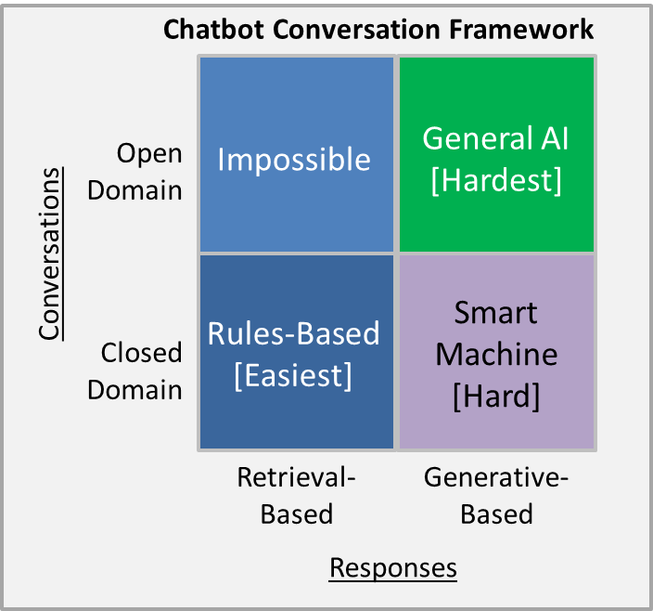
Q&A integration with CHATBOT
Healthcare professionals, Retailers and healthcare consumers have information needs that can be met through the use of chatbots/dialog agents, specifically via medical question answering systems.
However, the information needs of both groups are different in terms of literacy levels and technical expertise, and an effective question answering system must be able to account for these differences if it is to formulate the most relevant responses for users from each group.
State of the art approaches incorporate seq2seq models (RNN/LSTM based Deep neural networks) to build an efficient question answering system which mimics human interaction to a greater extent. (Generative based models)

